Slide 1
Tutorials 12
Statistical Computation and Analysis
Spring 2024

Slide 2
Tutorial Outline
Bootstrap:
parametric
non-parametric/regular
paired/unpaired
Confidence Intervals
Parametric Confidence Intervals
Mean
Regression Coefficient

Slide 3
Bootstrap
Create the estimator distribution.
Method: Simulate repeating the experiment again and again.
Parametric
Non-parametric

Slide 4
Bootstrap
Parametric: assume the sample data comes from a known distribution and the sample represents the population.
Collect a sample
Assume a model
Estimate model parameters from the sample
Generate new samples from the distribution using the calculated parameters.
Calculate estimator value using the sample.
Repeat until you have a distribution for the estimator.

Slide 5
Bootstrap
Non-parametric: assume the population has the same distribution as the sample.
Generate new samples from the sampled data.
Sample with repetition.
Calculate estimator value using the sample.
Repeat until you have a distribution for the estimator.

Slide 6
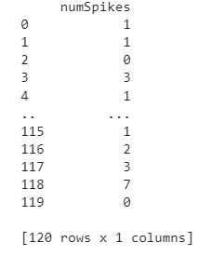
Bootstrap Example
We recorded activity of one neuron and counted a number of spikes (action potentials) per second
We want the distribution of the mean estimator (lambda of Poisson distribution)

Slide 7
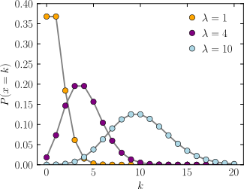
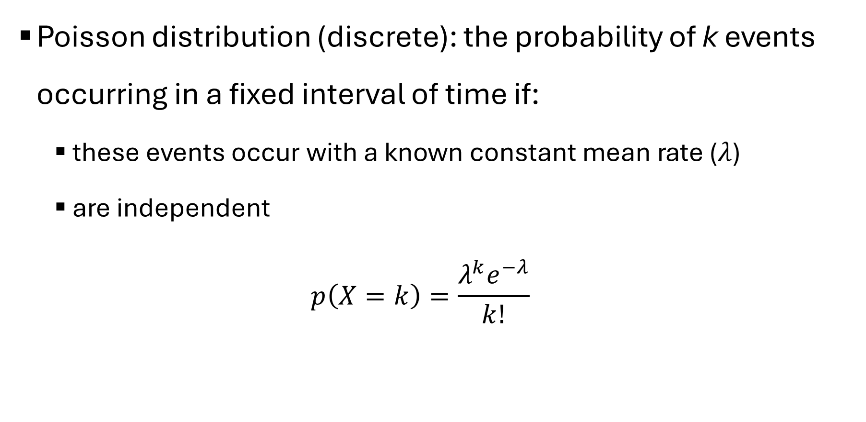
Bootstrap Example
Poisson distribution (discrete): the probability of k events occurring in a fixed interval of time if:
these events occur with a known constant mean rate ($λ$)
are independent
$$p\left(X=k\right)=\frac{λ^{k}e^{−λ}}{k!}$$

Slide 8
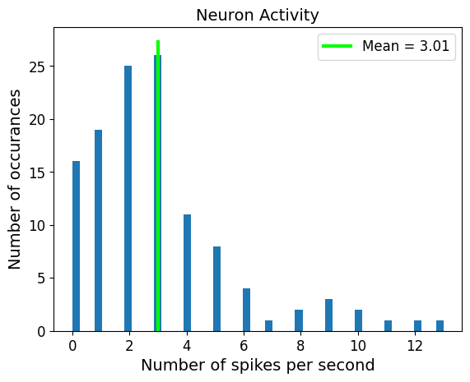
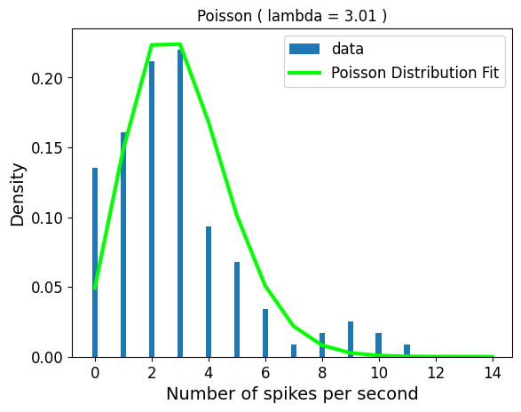
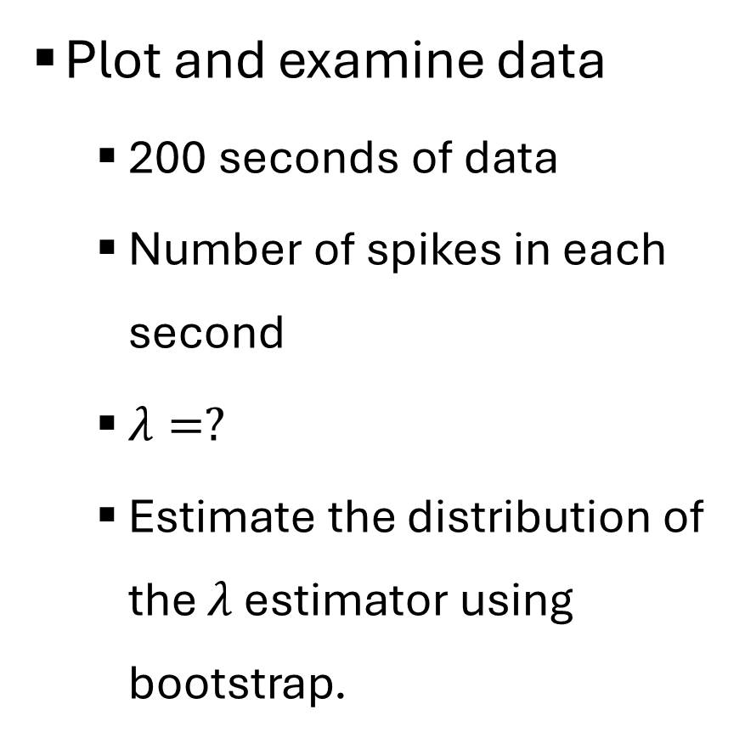
Bootstrap Example
Plot and examine data
200 seconds of data
Number of spikes in each second
$λ=?$
Estimate the distribution of the $λ$ estimator using bootstrap.

Slide 9
Bootstrap Example
Parametric bootstrap
num_boot = 2000 #number of bootstrap repetitions
boot_data = np.random.poisson(data_mean, size = (data_len, num_boot) ) #select the same sample size as the original from poisson distribution
#distribution parameter (lambda) is computed from sample
boot_mean = boot_data.mean(axis = 0) #mean of each sample
#plot results
plt.hist(boot_mean, label = 'bootstrap means')
plt.plot([data_mean,data_mean], plt.gca().get_ylim(), color = 'lime', lw = 3, label = 'original data mean')

Slide 10
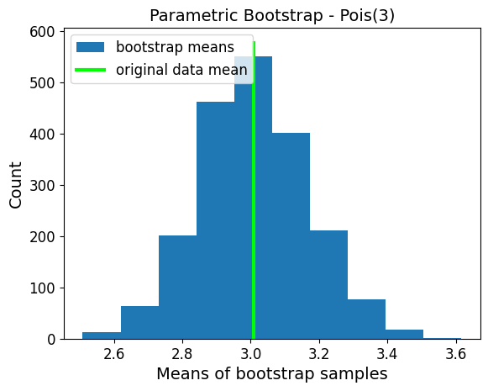
Bootstrap Example
Parametric bootstrap

Slide 11
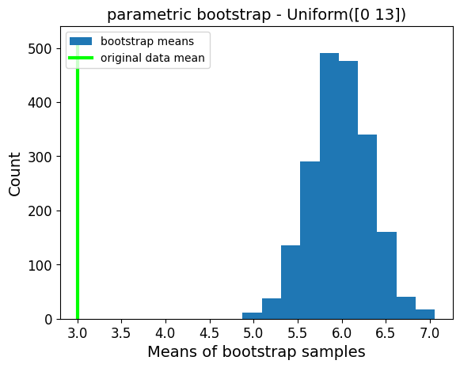
Bootstrap Example
Parametric bootstrap – wrong distribution (unreasonable model)
Notes:
Range based on range in data. This shows the importance of modelling the data correctly.
As expected, average of numbers between 0 and 13 is approximately 6.
What makes an unreasonable model?
Look at where our original stastic

Slide 12
Bootstrap Example
Non-parametric bootstrap
Sample from data with repetitions: 2000 samples of 200
num_boot = 2000
boot_data = np.random.choice(spikes_data, size = (data_len,num_boot) , replace=True) # resample from data with repetitions
boot_mean = boot_data.mean(axis = 0)

Slide 13
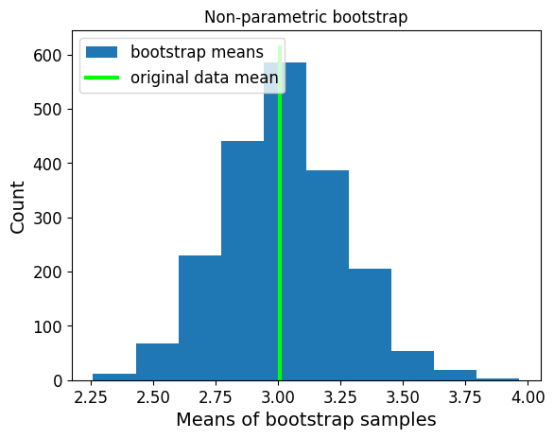
Bootstrap Example
Non-parametric bootstrap

Slide 14



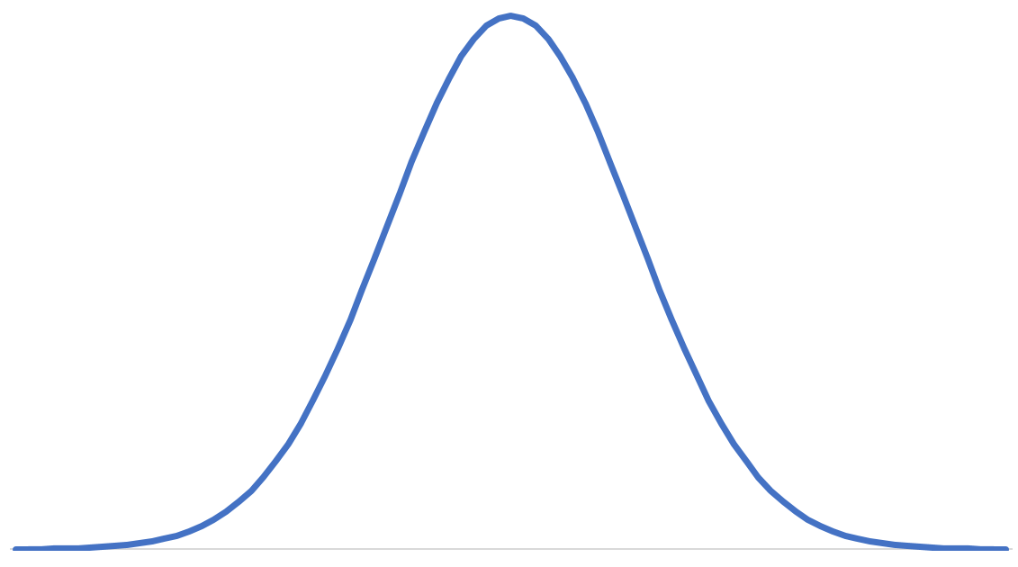
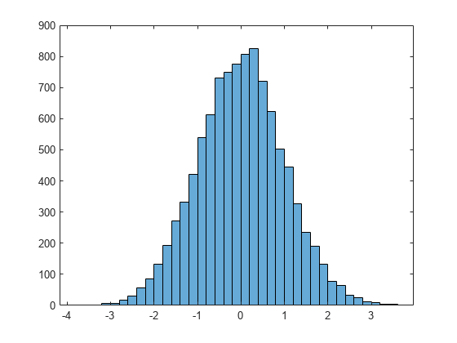
Bootstrap Summary
Parametric
Non – Parametric
Sample
Sample
Assumed Population Model
Statistic
Statistic
Statistic
Estimator Distribution
Sample
Sample
Sample
Statistic
Statistic
Statistic
Statistic

Slide 15
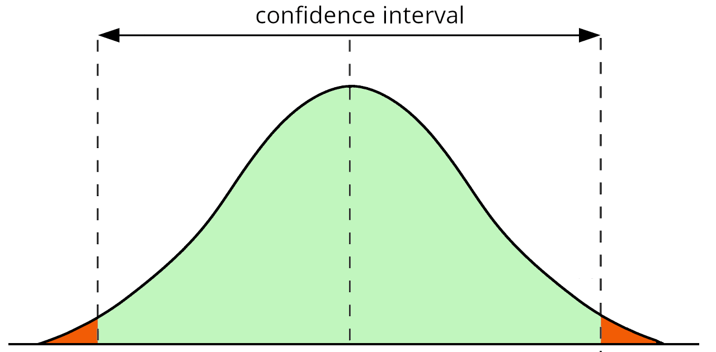
Confidence Interval
An interval that contains the parameter being estimated x% of the time.
For example, x = 92 gives the 92% confidence interval.
The range containing x% of the estimator distribution.

Slide 16
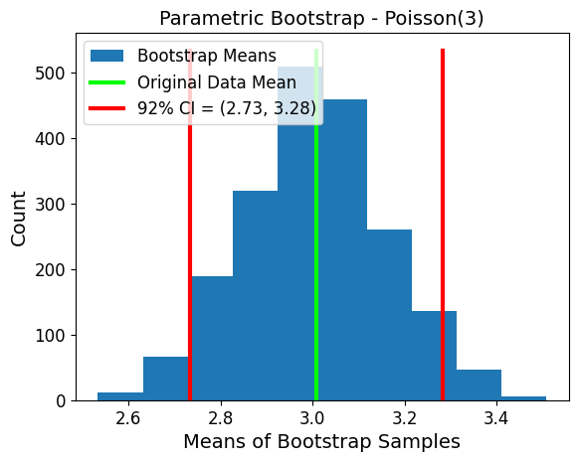
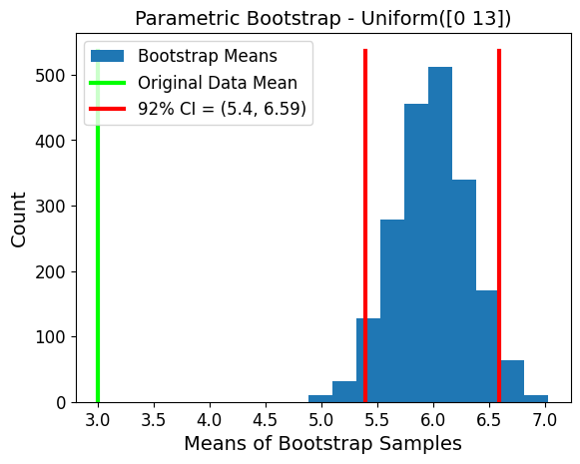
Confidence Interval

Slide 17
Effect Size
We want to measure the difference in verbal comprehension in children aged 3 and 5.
We are given a table with comprehension scores of two groups of children: 30 – aged 3, 30 - aged 5
comprehension = [[5,6,8,12,11,9,7,6,8,7,8,12,5,6,7,8,11,7,7,5,3,4,10,6,6,5,7,6,5,6],
[6,7,9,13,12,10,11,8,10,9,8,13,6,14,6,11,12,10,9,4,5,12,11,2,7,8,7,6,6,7]]

Slide 18
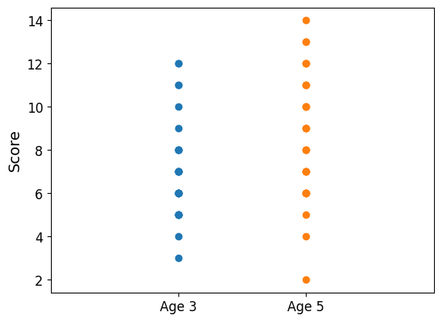
Effect Size
Examine the data.
Effect size = 0.58
Medium effect

Slide 19
Effect Size
comprehension = [[5,6,8,12,11,9,7,6,8,7,8,12,5,6,7,8,11,7,7,5,3,4,10,6,6,5,7,6,5,6],
[6,7,9,13,12,10,11,8,10,9,8,13,6,14,6,11,12,10,9,4,5,12,11,2,7,8,7,6,6,7]]
group1 = np.array(comprehension[0])
group2 = np.array(comprehension[1])
sample1_mean = group1.mean()
sample2_mean = group2.mean()
sample1_var = group1.var(ddof=1) #unbiased estimator
sample2_var = group2.var(ddof=1)
sd_comb = np.sqrt(((group1.shape[0]-1)*sample1_var + (group2.shape[0]-1)*sample2_var)/(group1.shape[0] + group2.shape[0] - 2))
effect_size = (sample2_mean-sample1_mean)/sd_comb

Slide 20
Paired and Unpaired Bootstrap
Unpaired

Slide 21
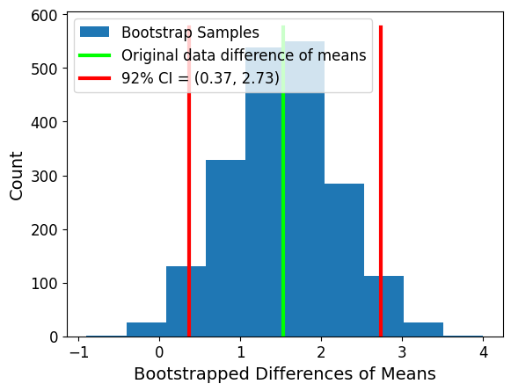
Paired and Unpaired Bootstrap (Non – parametric)
Unpaired

Slide 22
Paired and Unpaired Bootstrap (Non – parametric)
Unpaired
num_boot = 2000
boot_group1 = np.random.choice(group1,size = (len(group1),num_boot)) #resample 3 year olds
boot_group2 = np.random.choice(group2,size = (len(group1),num_boot)) #resample 5 year olds
boot_mean1 = boot_group1.mean(axis = 0) #compute means
boot_mean2 = boot_group2.mean(axis = 0)
boot_diff_means = boot_mean2-boot_mean1 #compute difference between means

Slide 23
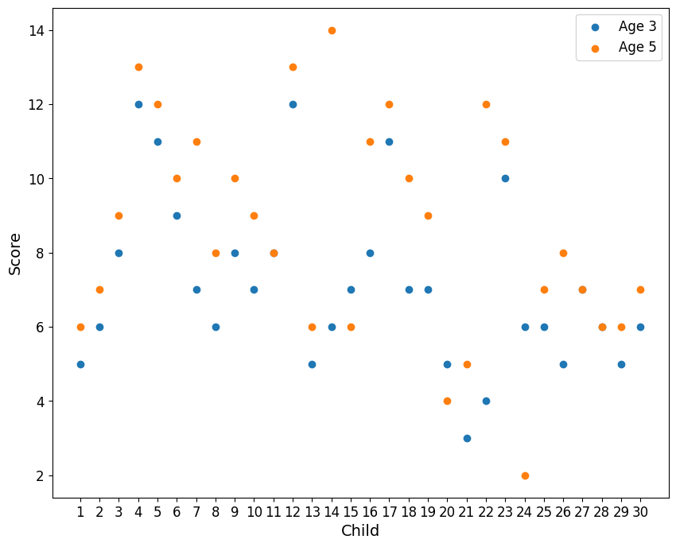
Paired and Unpaired Bootstrap (Non – parametric)
Paired

Slide 24
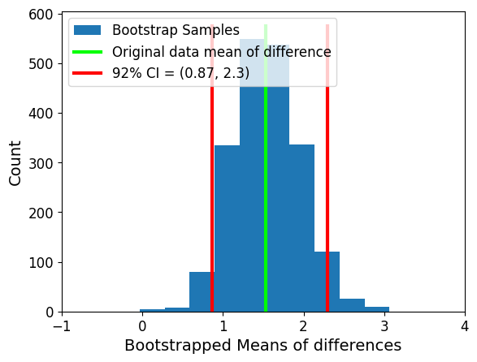
Paired and Unpaired Bootstrap (Non – parametric)
Paired

Slide 25
Paired and Unpaired Bootstrap (Non – parametric)
Paired
data_diff = group2-group1 #compute difference between each child at ages 3 and 5
boot_diff = np.random.choice(data_diff, size = (len(group1),num_boot)) #resample the differences
boot_mean_diff = boot_diff.mean(axis = 0) #then compute mean of differences

Slide 26
Paired and Unpaired Bootstrap (Non – parametric)
Unpaired
Paired
Effect size = 0.58
Effect size = 0.58
Paired vs. unpaired effects confidence interval
Paired vs. unpaired does not affect effect size

Slide 27
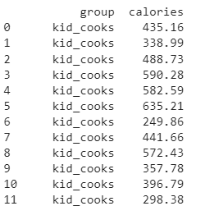
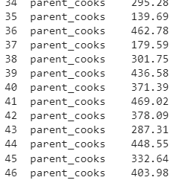
Comparison Between Two Groups
An experiment was conducted to determine the effect of children participating in meal preparation on caloric intake.
Group 1: 25 children participated in meal preparation
Group 2: 22 children did not participate (the parents cooked alone).

Slide 28
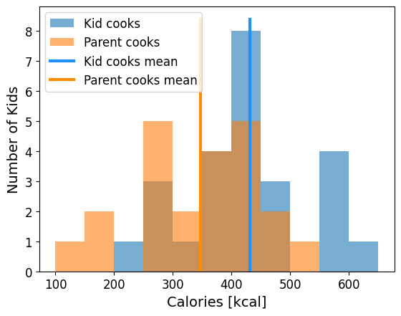
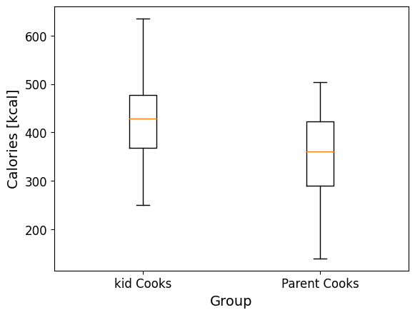
Comparison Between Two Groups
Examine the data
Effect size = 0.82 – large effect
On average, kids that helped cook had a higher caloric intake
Notes:
Look at the data and compute the mean. We can see that on average kids that helped cook had a higher caloric intake

Slide 29
Comparison Between Two Groups
bin_edges = np.arange(100,700,50)
plt.hist(group1,bins = bin_edges, alpha = 0.6, label = 'Kid cooks')
plt.hist(group2, bins = bin_edges, alpha = 0.6, label = 'Parent cooks’)
plt.boxplot([group1, group2] , positions = np.array((1,2)) ) plt.xticks((1,2) , ('kid Cooks' , 'Parent Cooks'), fontsize = 12)

Slide 30
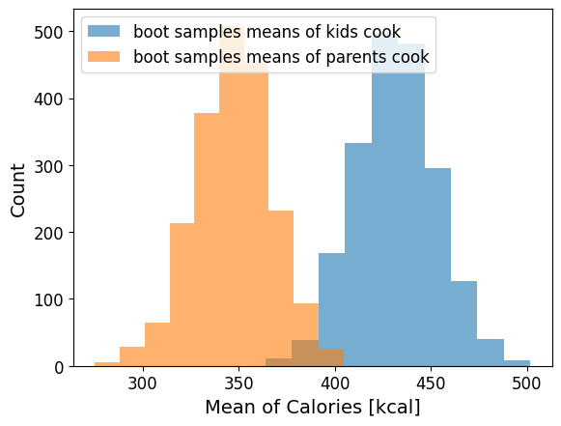
Comparison Between Two Groups
Estimate difference of means
Bootstrap our sample - unpaired

Slide 31
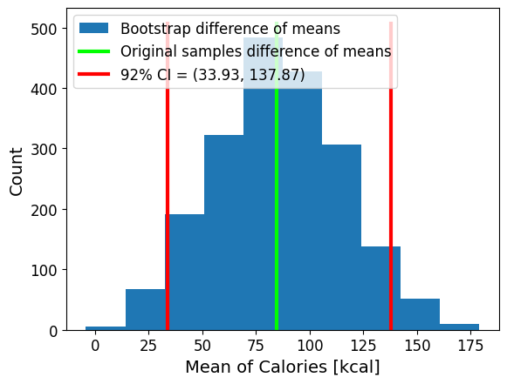
Comparison Between Two Groups
Difference of bootstrap means – unpaired
Kid cooks minus parent cooks

Slide 32
Comparison Between Two Groups
num_boots = 2000
boot_samples1 = np.random.choice(group1, size = (len(group1),num_boots))
boot_samples2 = np.random.choice(group2, size = (len(group2),num_boots))
boot_samples1_means = boot_samples1.mean(axis = 0)
boot_samples2_means = boot_samples2.mean(axis = 0)
boot_samples_diff_means = boot_samples1_means-boot_samples2_means
conf = 0.92
ci92 = np.percentile(boot_samples_diff_means, [100*(1-conf)/2,100*(1-(1-conf)/2)]) #[4, 96]

Slide 33
Parametric Confidence Intervals
A way to generate confidence intervals without using bootstrap.
First, we need to define the estimator distribution.

Slide 34
Bootstrap Summary
Parametric
Non – Parametric
Sample
Sample
Assumed Population Model
Statistic
Statistic
Statistic
Estimator Distribution
Sample
Sample
Sample
Statistic
Statistic
Statistic
Statistic

Slide 35
Estimator Distribution From Equation
Sample
Estimator Distribution
Statistic
When can we do this?

Slide 36
Distribution of the Mean Estimator
Parametric
Non – Parametric
Sample
Estimator of mean is normally distributed
Sample
Assumed Population Model
Mean
Mean
Mean
Mean Estimator Distribution
Sample
Sample
Sample
Mean
Mean
Mean
Sample Means

Slide 37
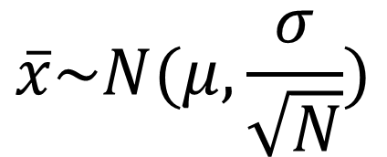
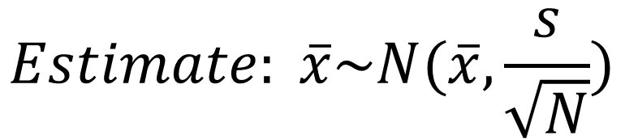
Distribution of the Mean Estimator
$$\overline{x}\sim N(μ,\frac{σ}{\sqrt{N}})$$
The sample mean is distributed normally
Even if the data is not
If the sample size is large enough
The mean of the sample mean is:
the mean of the population
The variance of the sample mean is:
Proportional to the variance of the population
Inversely proportional to the sample size
$$Estimate: \overline{x}\sim N(\overline{x},\frac{s}{\sqrt{N}})$$
Notes:
Big enough – N>=30 (central limit theorm). Even N = 10 is often enough

Slide 38
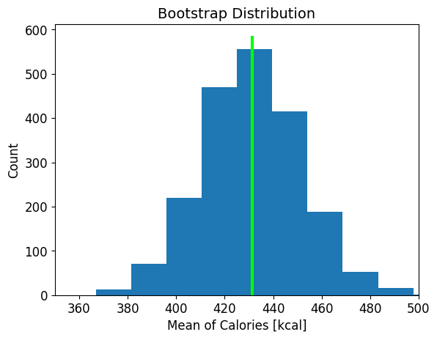
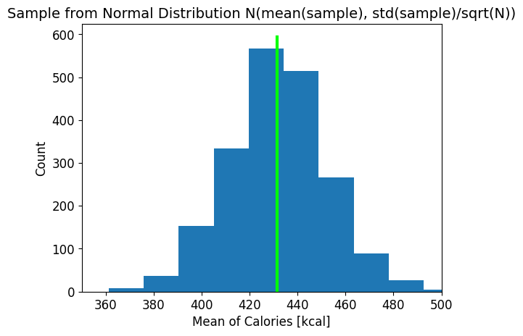
Distribution of the Mean Estimator

Slide 39
Distribution of the Mean Estimator
plt.hist(boot_samples1_means, label = 'Bootstrap Means of Kid Group')
plt.plot([group1_mean,group1_mean], plt.gca().get_ylim(),
color = 'lime', lw = 3, label = 'Original Sample Mean')
plt.title('Bootstrap Distribution', fontsize = 14)
ParametricSample = np.random.normal(group1_mean, group1.std(ddof = 1)/(group1.shape[0]**0.5), (boot_samples1_means.shape[0], 1))
plt.hist(ParametricSample, label = 'Sampled Means from Normal Distribution')
plt.plot([group1_mean,group1_mean],plt.gca().get_ylim(),
color = 'lime', lw = 3, label = 'Original Sample Mean')
plt.title('Sample from Normal Distribution N(mean(sample), std(sample)/sqrt(N))', fontsize = 14)

Slide 40
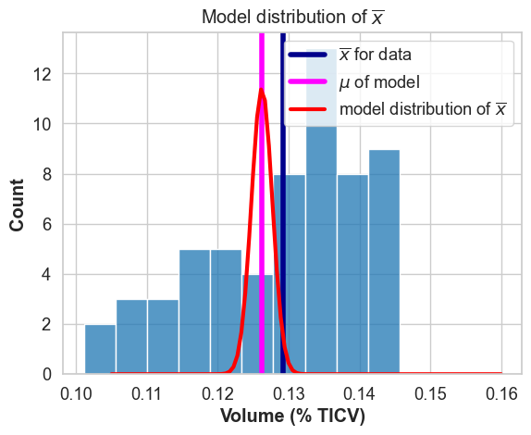
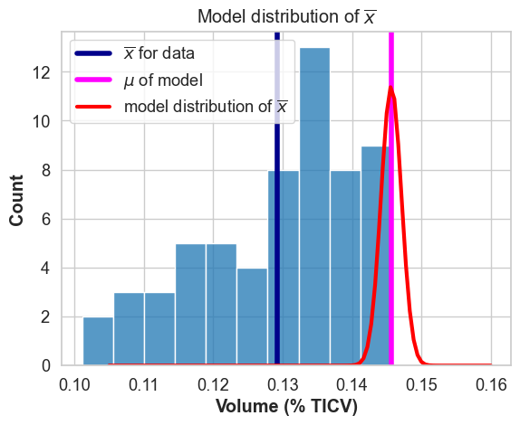
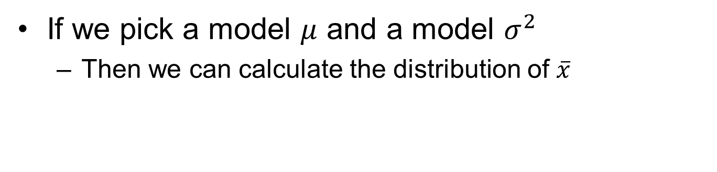
Any model has a distribution for the sample mean
If we pick a model $μ$ and a model $σ^{2}$
Then we can calculate the distribution of $\overline{x}$

Slide 41
Estimate standard deviation
Using the standard error of the mean

Slide 42
t distribution for confidence intervals
We can build the confidence interval just like before

Slide 43
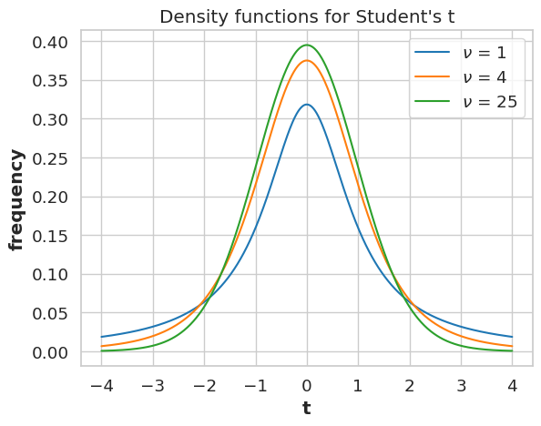
Parametric Confidence Intervals
t – distribution

Slide 44

Parametric Confidence Intervals
Confidence interval limits
$$\overline{x}=sample mean$$
$$s_{\overline{x}}=standard error (standard deviation of sample over square root of sample size)$$
$$t_{N−1}^{\frac{a}{2}}=inverse of cumulative t distribution with N−1 degrees of freedom at\frac{α}{2}$$

Slide 45
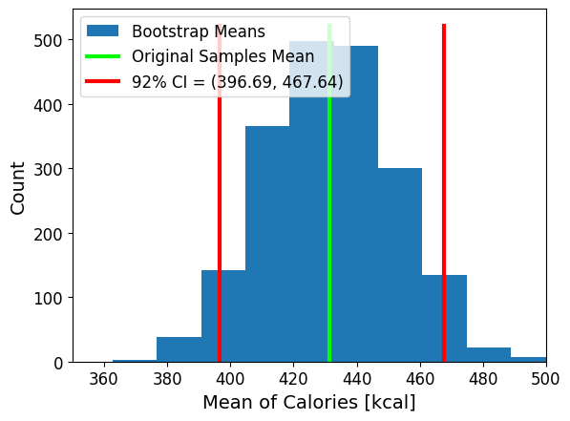
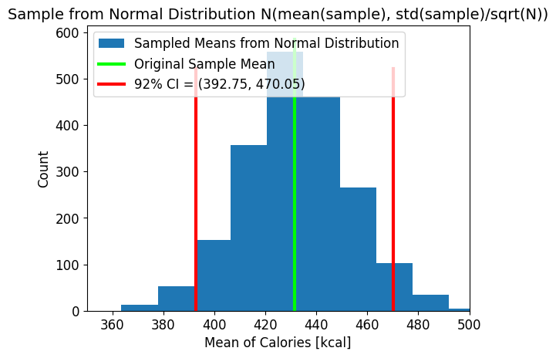
Parametric Confidence Intervals

Slide 46
Distribution of the Mean Estimator
%bootstrap confidence intervals
conf = 0.92
ci92 = np.percentile(boot_samples1_means, [100*(1-conf)/2,100*(1-(1-conf)/2)]) #[4, 96]
%parametric confidence intervals
N = group1.shape[0]
Group1_mean = group1.mean()
group1_se = group1.std(ddof = 1)/(N**0.5)
t_ci92 = stats.t.ppf([0.04,0.96], N - 1)
CI92 = group1_mean + group1_se*t_ci92

Slide 47
How do we calculate confidence intervals?
Bootstrap – any statistic
Parametric – sample mean
Sample
Sample
Bootstrap (parametric / non-parametric)
1. Sample mean (mean())
2. Sample Size (len())
3. Standard error (std(ddof = 1)/N**0.5)
Estimator Distribution
t_ci92 = stats.t.ppf([0.04,0.96], N - 1)
CI92 = sample_mean + se*t_ci92
Statistic
conf = 0.92
ci92 = np.percentile(boot_samples, [100*(1-conf)/2,100*(1-(1-conf)/2)]) #[4, 96]

Slide 48
Another Example with Parametric CI
Two groups: 13 musicians and 23 non-musicians
Each participant reacted to two types of stimuli: visual and auditory.
After seeing or hearing a stimulus they had to press a button. We have the file with the reaction time.
72 measurements: 36 auditory and 36 visual

Slide 49
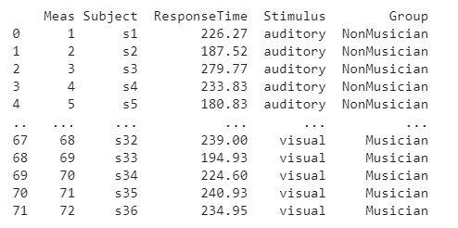
Visualization

Slide 50
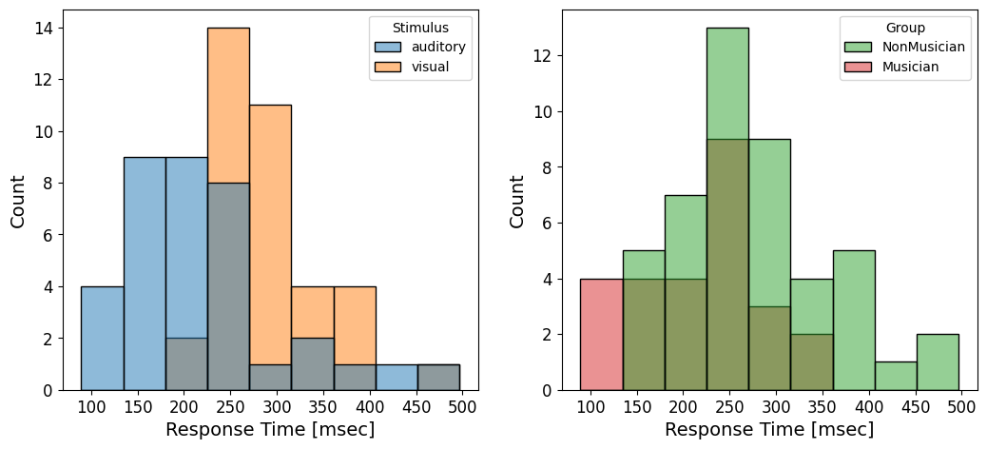
Visualization
Histogram with separation by group

Slide 51
Visualization
Histogram with separation by group
fig = plt.figure()
plt.subplot(1, 2, 1)
sns.histplot(data=data, x = 'ResponseTime', hue = 'Stimulus')
plt.subplot(1, 2, 2)
sns.histplot(data=data, x = 'ResponseTime', hue = 'Group', palette = ['C2', 'C3'])

Slide 52
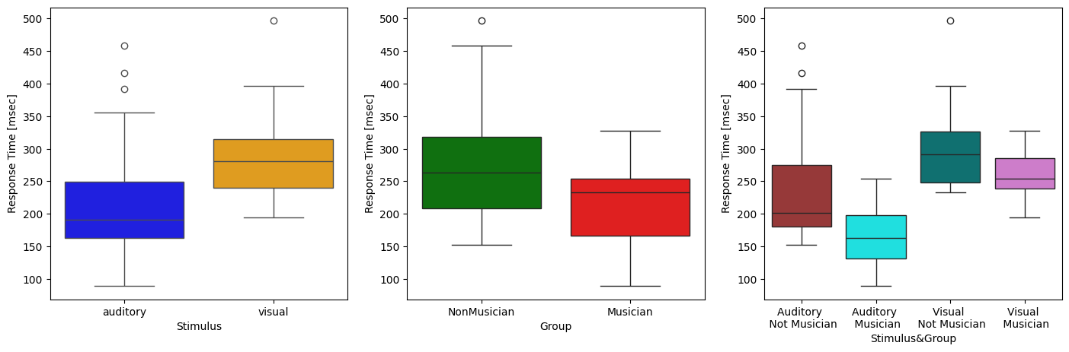
Visualization
Boxplot

Slide 53
Visualization
Boxplot
sns.boxplot(ax=ax[0], data=data, x = 'Stimulus', y = 'ResponseTime', hue = 'Stimulus', palette = {'auditory':'blue', 'visual':'orange'})
sns.boxplot(ax=ax[1], data=data, x = 'Group', y = 'ResponseTime', hue = 'Group', palette = {'NonMusician':'g', 'Musician':'r'})
sns.boxplot(ax=ax[2], data=data, x = 'stim_group', y = 'ResponseTime', hue = 'stim_group’, palette = {'auditory musician':'cyan', 'auditory nonmusician':'brown', 'visual musician': 'orchid', 'visual nonmusician': 'teal'})

Slide 54
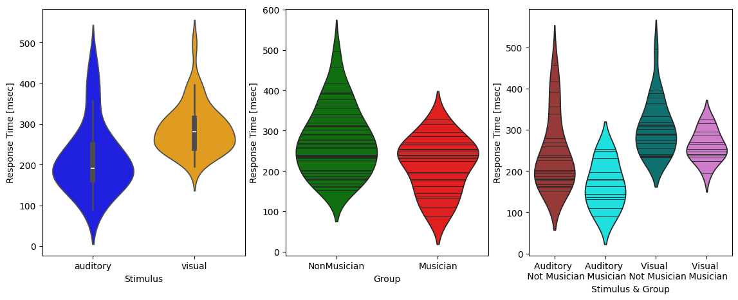
Visualization
Violin plot
Notes:
The width of each curve corresponds with the approximate frequency of data points in each region
#the lines (sticks) show each data point
The other option is a mini box plot in the violin plot
Violin plots are used when you want to observe the distribution of numeric data, and are especially useful when you want to make a comparison of distributions between multiple groups. The peaks, valleys, and tails of each group’s density curve can be compared to see where groups are similar or different. Additional elements, like box plot quartiles, are often added to a violin plot to provide additional ways of comparing groups,

Slide 55
Visualization
Violin plot
sns.violinplot(ax=ax[0], data=data, x = 'Stimulus', y = 'ResponseTime', hue = 'Stimulus', palette = {'auditory':'blue', 'visual':'orange'})
sns.violinplot(ax=ax[1], data=data, x = 'Group', y = 'ResponseTime', inner = 'stick', hue ='Group', palette = {'NonMusician':'g', 'Musician':'r'})
sns.violinplot(ax=ax[2], data=data, x = 'stim_group', y = 'ResponseTime', inner = 'stick', hue = 'stim_group', palette = {'auditory musician':'cyan', 'auditory nonmusician':'brown', 'visual musician': 'orchid', 'visual nonmusician': 'teal'})

Slide 56
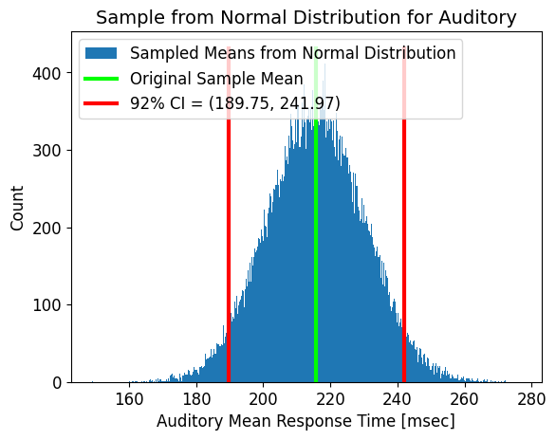
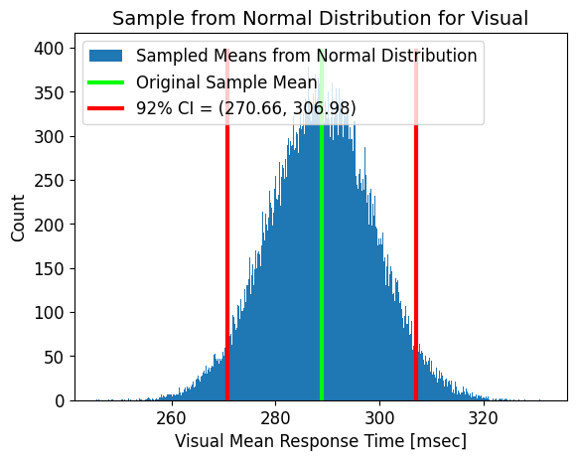
Mean Response Time to Auditory and Visual

Slide 57
Mean Response Time to Auditory and Visual
t_ci92 = stats.t.ppf([0.04,0.96], N1 - 1)
CI92 = m1 + (s1/N1**0.5)*t_ci92 #All we need to do to get our confidence intervals
ParametricSample = np.random.normal(m1, s1/(N1**0.5), (100000, 1))
plt.figure()
ax = plt.subplot(1,1,1)
plt.hist(ParametricSample, bins = 1000, label = 'Sampled Means from Normal Distribution')
ys = plt.gca().get_ylim()
plt.plot([m1, m1], ys, color = 'lime', lw = 3, label = 'Original Sample Mean')
plt.plot([CI92,CI92], ys ,color = 'red', lw = 3, label = f'92% CI = ({round(CI92[0], 2)}, {round(CI92[1], 2)})')

Slide 58

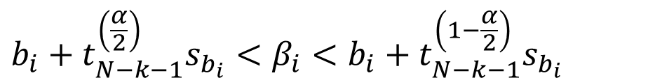
Confidence Intervals for the Regression Coefficients
$$b_{i}+t_{N−k−1}^{\left(\frac{α}{2}\right)}s_{b_{i}}<β_{i}<b_{i}+t_{N−k−1}^{\left(1−\frac{α}{2}\right)}s_{b_{i}}$$
Confidence interval for the regression coefficients
$α=0.08$
N = size of data
k = number of independent variables
$s_{b_{i}}= ?$
$s_{b}^{2}=s_{y|X}^{2}{\left(X^{T}X\right)}^{−1}$

Slide 59
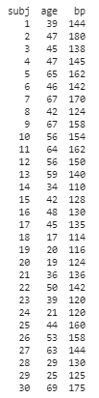
Example
We would like to describe the relationship between age and blood pressure. We gathered data from 30 healthy people.
x – age
y – blood pressure

Slide 60
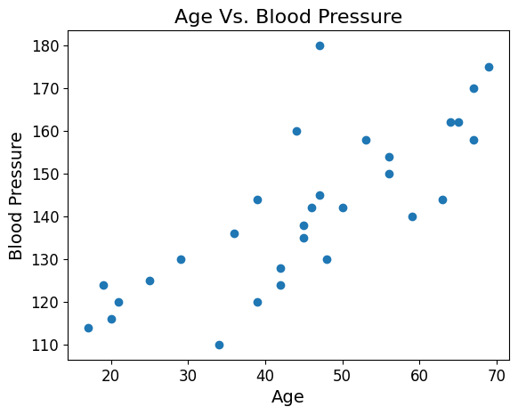
Example
1. Plot the data

Slide 61
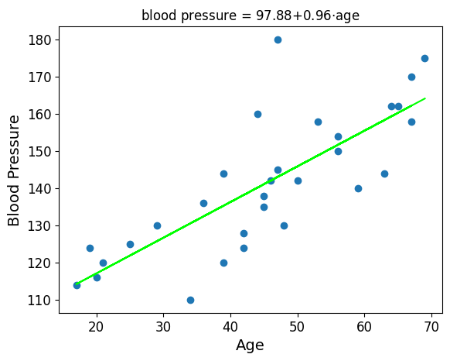
Example
2. Fit regression line
regr_model = LinearRegression().fit(x, y)
b0 = regr_model.intercept_
b1 = regr_model.coef_
yhat = b0 + b1*x

Slide 62

Example
3. Calculate sums of squares (SSres, SSreg)
a. $SS_{res}=\sum_{n=1}^{N}{{\left(y_{n}− \hat{y}\right)}^{2}}$
SSres = np.dot((y-yhat),(y-yhat))
SSres = 3886.938
b.$SS_{reg}=\sum_{n=1}^{N}{{\left(\overline{y}− \hat{y}\right)}^{2}}$
SSreg = np.dot((y.mean()-yhat),(y .mean()-yhat))
SSreg = 6249.861

Slide 63

Example
5. Calculate the variance of the residuals${ s}_{y|X}^{2}$
$s_{y|X}^{2}=\frac{SS_{res}}{N−k−1}$
k = number of independent variables = 1
N = sample size
N-k-1 = 30 – 1 – 1 = 28
$s_{y|X}^{2}=\frac{3886.938}{28}=138.819$

Slide 64

Example
5. Calculate the variance of the coefficients
$s_{b}^{2}=s_{y|X}^{2}{\left(X^{T}X\right)}^{−1}$
$s_{b}=\sqrt{s_{b}^{2}}$
$s_{b}= \left(\begin{matrix}6.805 & 0 \\ 0 & 0.143\end{matrix}\right)$
$s_{b_{0}}=6.805, s_{b_{1}}=0.143$

Slide 65

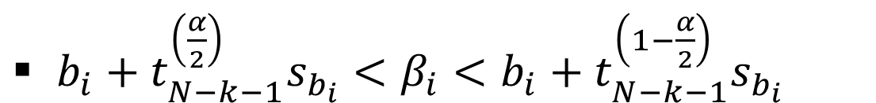
Example
6. Calculate the coefficients confidence intervals
$s_{b_{i}}$ - we just calculated
$b_{i}$ - our regression coefficients which we calculated
N – k – 1 = 28
$b_{i}+t_{N−k−1}^{\left(\frac{α}{2}\right)}s_{b_{i}}<β_{i}<b_{i}+t_{N−k−1}^{\left(1−\frac{α}{2}\right)}s_{b_{i}}$

Slide 66

Example
6. Calculate the confidence intervals for b0
$s_{b_{0}}$= $6.805$
$b_{0}$ = 97.88
N – k – 1 = 28
92% confidence intervals = [85.516, 110.241]
$b_{i}+t_{N−k−1}^{\left(\frac{α}{2}\right)}s_{b_{i}}<β_{i}<b_{i}+t_{N−k−1}^{\left(1−\frac{α}{2}\right)}s_{b_{i}}$

Slide 67

Example
6. Calculate the confidence intervals for b1
$s_{b_{1}}$= $0.143$
$b_{1}$ = 0.96
N – k – 1 = 28
92% confidence intervals = [0.699, 1.219]
$b_{i}+t_{N−k−1}^{\left(\frac{α}{2}\right)}s_{b_{i}}<β_{i}<b_{i}+t_{N−k−1}^{\left(1−\frac{α}{2}\right)}s_{b_{i}}$

